Slide 1
Blazor and Web Assembly
Jon Worthington
October 8, 2019

Slide 2
What this presentation covers …
This will be mainly a coding demo
We will be learning how to create the front-end for a web application using C# in the browser instead of JavaScript
First I will demo the application we will be building
Then I will spend 5 minutes on slides talking about Blazor and Web Assembly
Then we will spend the remaining time coding our web application using Blazor and C#

Slide 3
What we will be making today …
Introduce workshop https://github.com/dotnet-presentations/blazor-workshop
Walk through final application

Slide 4
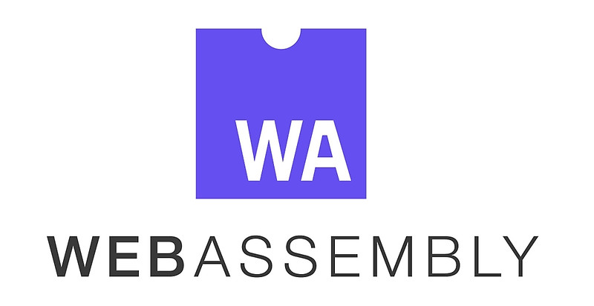
Web Assembly
Successor to ASM.JS
Web Assembly (WASM) is a low-level binary format language
That runs in modern web browsers
That runs at near-native speeds.
Browser standard
It’s a Compilation Target for other languages
No more JS monopoly

Slide 5
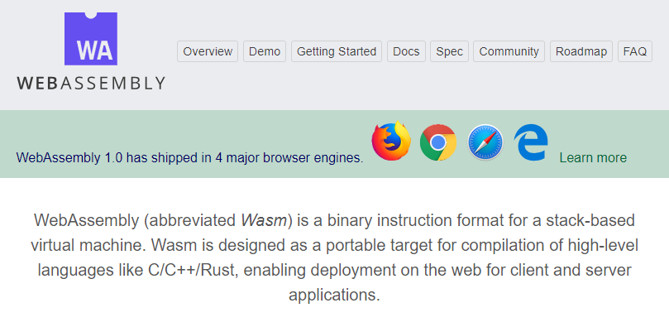
Web Assembly supported in all modern browsers as of 2017

Slide 6
What is Blazor?
Blazor is an C# implementation on Web Assembly
Enables you to run the .NET framework in the browser
Use C#/Razor to author your pages (instead of JavaScript)
Browser + C# = Blazor

Slide 7
What Blazor is NOT
Transpiled C# - you have whole .NET on frontend
Silverlight – you don’t need any plugin installed; it works on mobile!
Web Forms – it doesn’t try to work around web standards, it uses them

Slide 8
Blazor as part of .NET Core 3
Release date - September 2019
Two versions of Blazor: Server Side and Client Side
September Release includes only server-side Blazor
Client-side Blazor remains in preview
Moving from server-side to client-side will be one line of code

Slide 9
Blazor Project Types
Server-side Blazor (Razor Components): Creates a server-side Blazor app which is backed by ASP.NET Core and renders the components on the backend providing UI updates via Signal-R
Client-side Blazor: Creates a client-side Blazor app which can be hosted by any web server (standard JS/HTML/CSS). Backend can be your technology of choice – we will be using ASP.Net Core

Slide 10
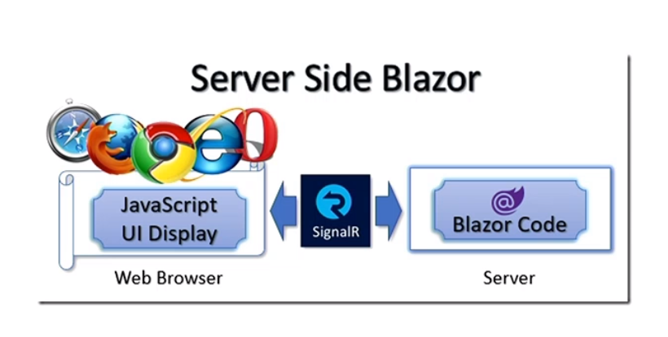
Server Side Blazor
Client app is executed on the server
All user interaction in browser are transported via Signal-R to server, which then executes client logic and transports back DOM updates

Slide 11
Pros and Cons of Server Side Blazor
Pros:
Browser doesn’t have to support WebAssembly to run this
App download size is significantly smaller
Useful for clients with limited resources
You can use server APIs on client side like IO
More secure – all source code stays on the server
Cons:
No offline support
Latency
Need better server hardware – server must manage multiple client connections and handle client state

Slide 12
Client Side Blazor
The principal hosting model for Blazor is running client-side in the browser on Web Assembly.
The Blazor app, its dependencies, and the .NET runtime are downloaded and executed in the browser.

Slide 13
Pros and Cons of Client Side Blazor
Pros
There's no .NET server-side dependency. The app is fully functioning after downloaded to the client.
Client resources and capabilities are fully leveraged.
Work is offloaded from the server to the client.
An ASP.NET Core web server isn't required to host the app. Serverless deployment scenarios are possible (for example, serving the app from a CDN).
Cons
The app is restricted to the capabilities of the browser.
Capable client hardware and software is required.
Download size is larger, and apps take longer to load.
.NET runtime and tooling support is less mature.

Slide 14
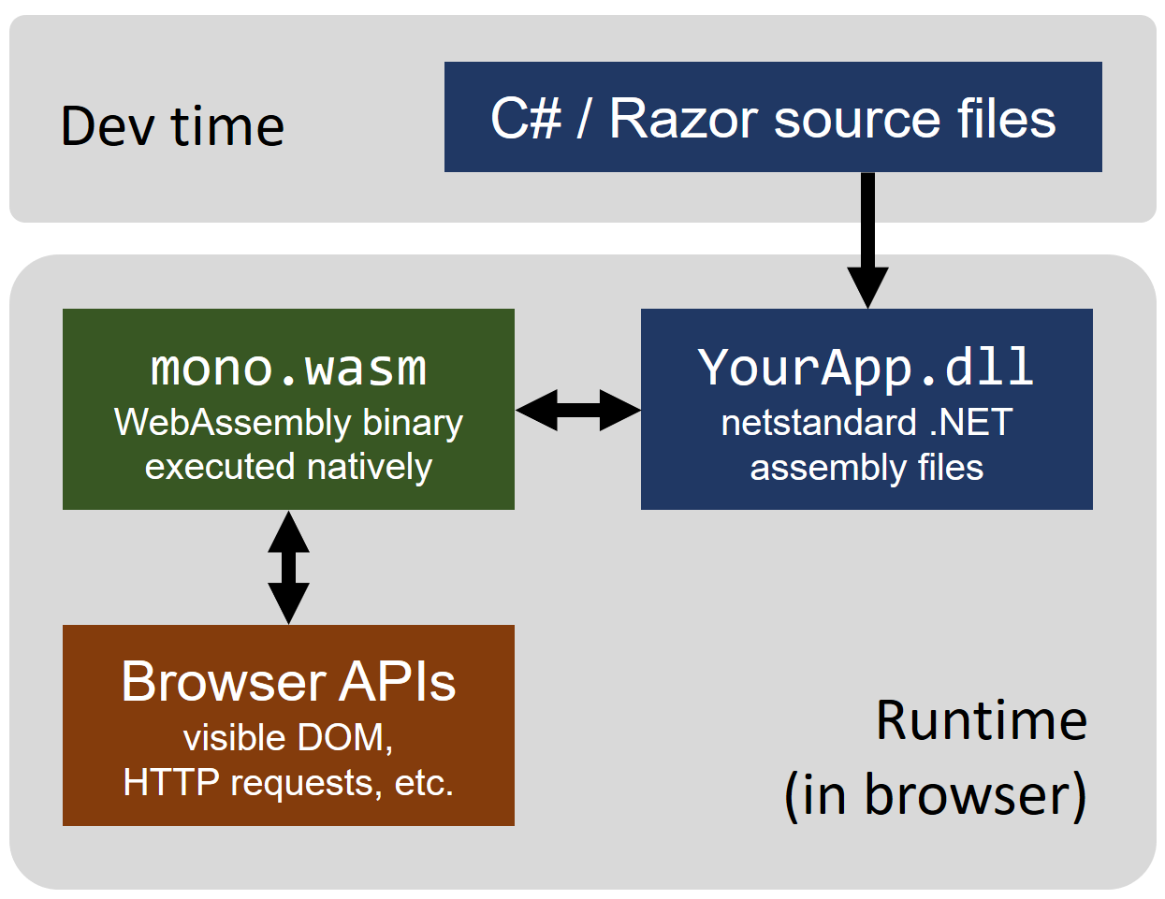
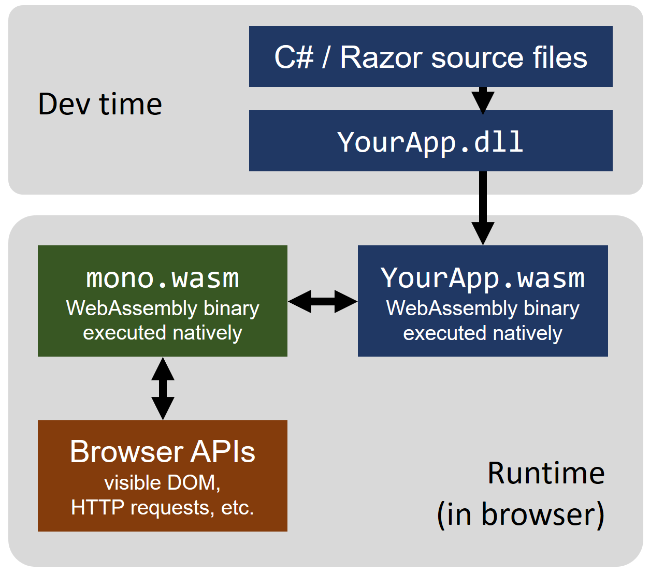
How Blazor Works
Today
Future

Slide 15
Problems with Client Side Blazor
Web Assembly is new
File size – larger than JavaScript (you download pretty much whole runtime) – Mitigated by tree shaking and caching
Performance – Mitigated by AOT compilation and improvements in WASM itself
Debugging is still under development

Slide 16
Demo – Blazor Workshop
https://github.com/dotnet-presentations/blazor-workshop

Slide 17
Links
Github https://github.com/worthingtonjg/Sort2019
Blazor Workshop https://github.com/dotnet-presentations/blazor-workshop
Getting started with Blazor https://docs.microsoft.com/en-us/aspnet/core/blazor/get-started?view=aspnetcore-3.0&tabs=visual-studio
.NET Core 3.0 SDK https://dotnet.microsoft.com/download/dotnet-core/3.0
Visual Studio 2019 Preview https://visualstudio.microsoft.com/vs/preview/
Blazor Documentation https://docs.microsoft.com/en-us/aspnet/core/blazor/?view=aspnetcore-3.0

